Slide 1




Slide 2
Table of Contents…...
Team Detail
Overview
Problems to Solve
Project objective
About Blood Donation
Solution
Features of Website
Conclusion

Slide 3

JODHPUR INSTITUTE OF ENGINEERING AND TECHNOLOGY,
JODHPUR.
Team members
ROHIT KANSARA (II year CSE)
VIKASH KUMAR (III YEAR CSE)
YOGESH SOLANKI (III YEAR CSE)
PRAVEEN KANSARA (I YEAR CSE)
Team Name – ALWAYS

Slide 4

Overview
Blood donation is one of the most significant contribution by human being. Which person contributes the blood for donation, they make the huge respect towards society.
When immediate and self service data is accessed that enables accelerated application development, faster testing and improve productivity.
We use Aadhar card because most of that data is correct and also used in every field, so we can find the right person.
“”

Slide 5
Problems to solve
To find an appropriate donor at the time of emergency.
Easy to find voluntary donor at every situation.
1
3
2
To find someone near by you.
4
To save time, to save someone’s “LIFE”.

Slide 6
Project objective
To create a website which help to get an appropriate blood donor which is available at the time of emergency or any situation at required place without wasting time.

Slide 7

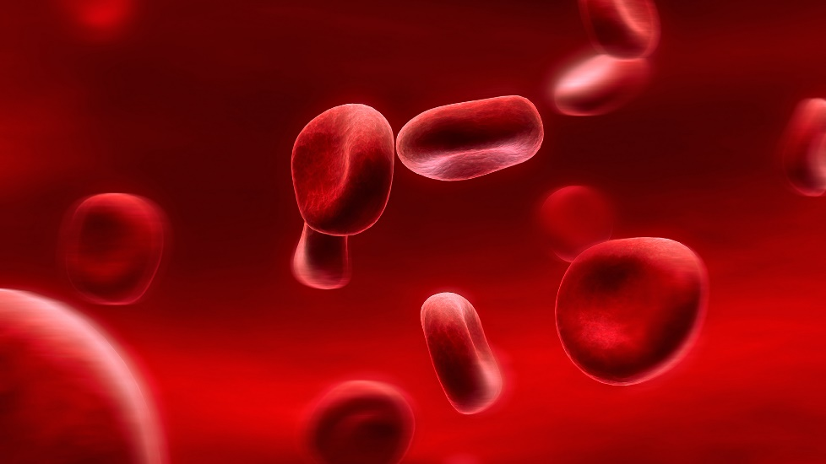

Let’s talk about some
About the need of Blood…

Slide 8

Every 2 ½ seconds someone needs a blood transfusion.
1 out of 3 people will need a blood transfusion in their lifetime.
1 unit of donated blood can save up to 4 lives.

Slide 9

Now the Question is ?

Slide 10

Why?
Why we add some new features in Aadhar?

Slide 11
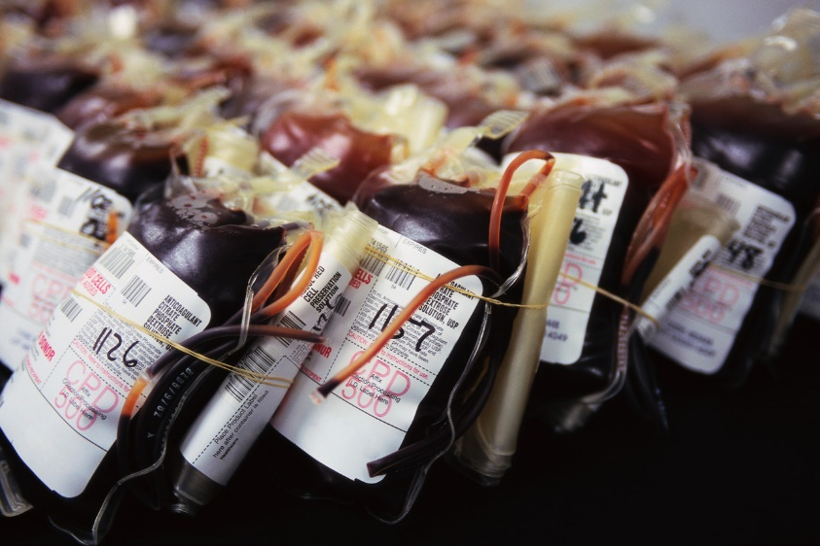
Because…
It takes 36-48 hours to perform at least 10 tests to ensure it is safe to transfuse.
This is TOO long in emergencies!

Slide 12

Then what is the solution???

Slide 13
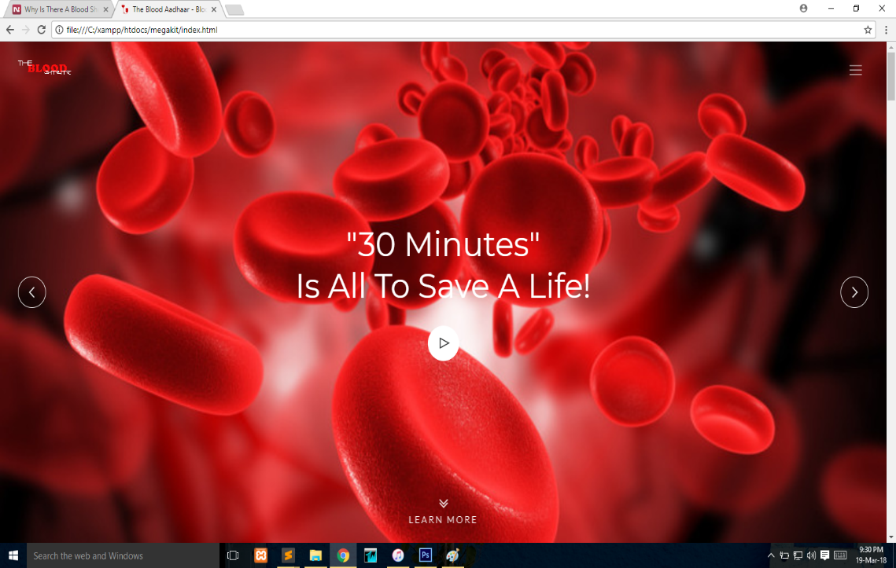
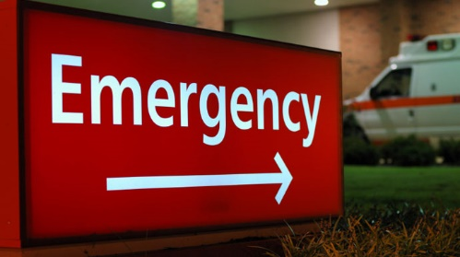
A Website which help to get an appropriate Donor.
At the time of

Slide 14
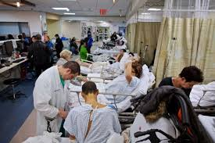
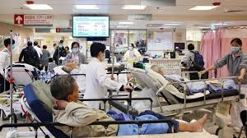
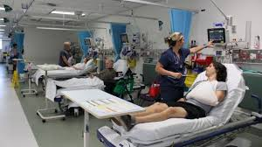
What kind of people need to be given blood?
1. Accident victims
2. Cancer patients
3. Premature infants
4. Sickle cell patients
5. Surgery patients
And MANY others

Slide 15
“Am I an acceptable donor?”
You must:
Be at least 17 years old
Weigh at least 110 lbs.
Be in good health
Know the names of any medications you
have recently taken
Have recently eaten a good meal

Slide 16
With the help of Aadhar Card.

Slide 17

“First you have to do………
Blood group with your Aadhar.

Slide 18
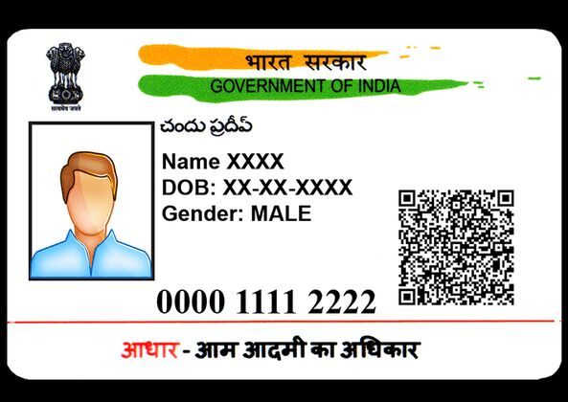
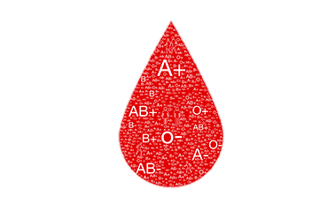
Add Blood Group in Aadhar
dcf
Blood Group : [ ]

Slide 19

When Aadhar is updated, the website use it’s database and sort the best result for user.

Slide 20

When a request came to our website.
Our site give a response.

Slide 21


The Sms is broadcasted to people who are already registered as Emerency donor for an Emerency.
It’s an emergency!!!
Blood is required…
<PLACE>
<CONTACT>

Slide 22

The website send a notification on Blood_Aadhar account.

Slide 23
IN ALL THREE OR FOUR PROCESSES
SIGN UP
User can create an account on site with UIDAI. And can update some features like present address, emergency contact numbers,etc.
LOG IN
User can access his/her account to request for blood online to our website, and also get notification when someone send any emergency alert.
SMS
User can directly send his/her general details like name, address where blood is needed, and contact info. Then website send an alert to all nearby emergency donors .
Emerency
When a patient is admitted in hospitals, by only getting his/her fingerprint they can find patient’s blood group, and send emerency alert to their emergency contacts.

Slide 24
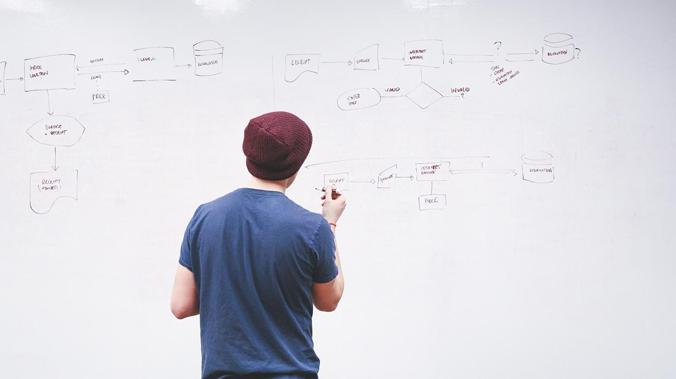
Our process is easy
Update your aadhar
Send Request of blood at Emergency
Get a Donor

Slide 25
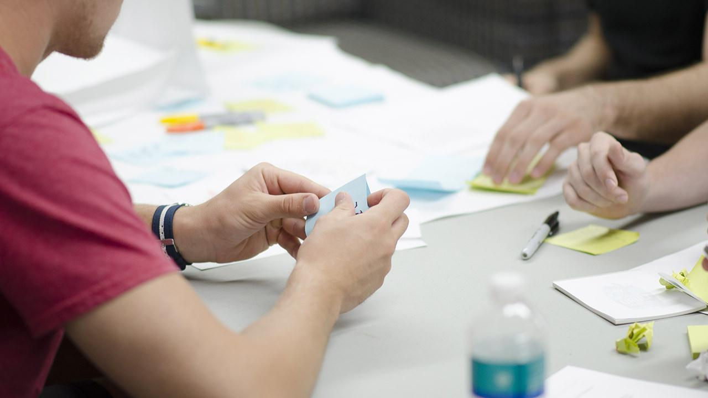
User’s Emergency info on website…
Some emergency information
Emergency Contacts
Doctor Name Contacts
Any type of allergy report
About Medication
Hospitals can send emergency message on given contact of patient. To inform their families.
These can be easily find by hospitals only getting Aadhar number by fingerprint scanner.

Slide 26


Events
The blood donation events in Hospitals, Institutes, and many other places are oragnised by our team,which details are updated on website every week.

Slide 27

Blogs
User can connect their blogs to our website.
If you write something about us please contact us.

Slide 28
Conclusion…
Now the conclusion of the site is, it will able to get an appropriate donor at any kind of situation. By sms service there is no requirement of internet connection.
By a single message a required person can find a perfect donor at minimum time.
30 minutes is all to save life , so donate blood and give the gift of life.

Slide 29
Thank you.

